Slide 1

Better Together: Text + Context
https://kwchurch.github.io/
Kenneth Church
Sept 2023

Slide 2
Recommendation: More than Word Overlap
Recommendations
What should I read?
What should I cite?
Many systems focus on ``relevance’’ (word overlap)
But we also want credibility
Don’t recommend papers that are buzz-word compliant
But not worth reading
(Most papers are never cited)

Slide 3
Agenda (for Final Presentation on YouTube) https://kwchurch.github.io/
1.5 hours
1.5 hours
Intro (Ken) – 20 min
Centroids/Related Work
(Rodolfo) – 15 min
Bins
(Shabnam) – 15 min
Forecasting over time
Losses + Time & Space
Production Runs
(Ben) – 10 min
Time & Space
Break – 30 minutes
Experiments
Perplexity (Abteen) – 20 min
Random Walks (Peter) – 10 min
Local Citation Prediction (Peter) – 10 min
Time prediction (Melissa) – 15 min
GNNs (Sandeep, Hui) – 15 min
Deliverables/Conclusions
(Ken) – 5 minutes
Questions – 15 min
https://github.com/kwchurch/JSALT_Better_Together

Slide 4
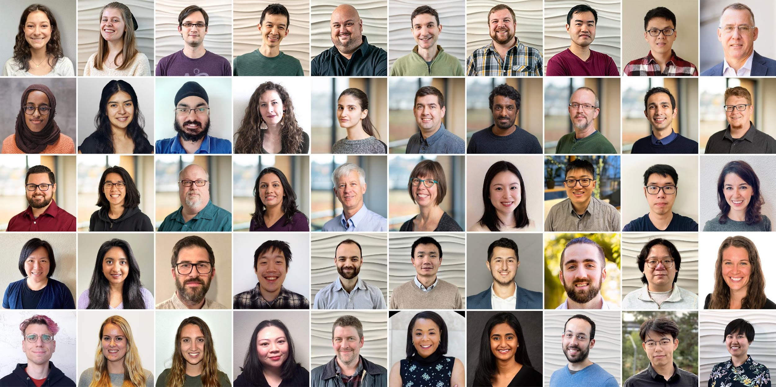
Semantic Scholar (S2): Significant Effort (slide from Dan Weld)
50 person team
7 year project
207M+ scientific paper index
8M+ monthly active users

Slide 5
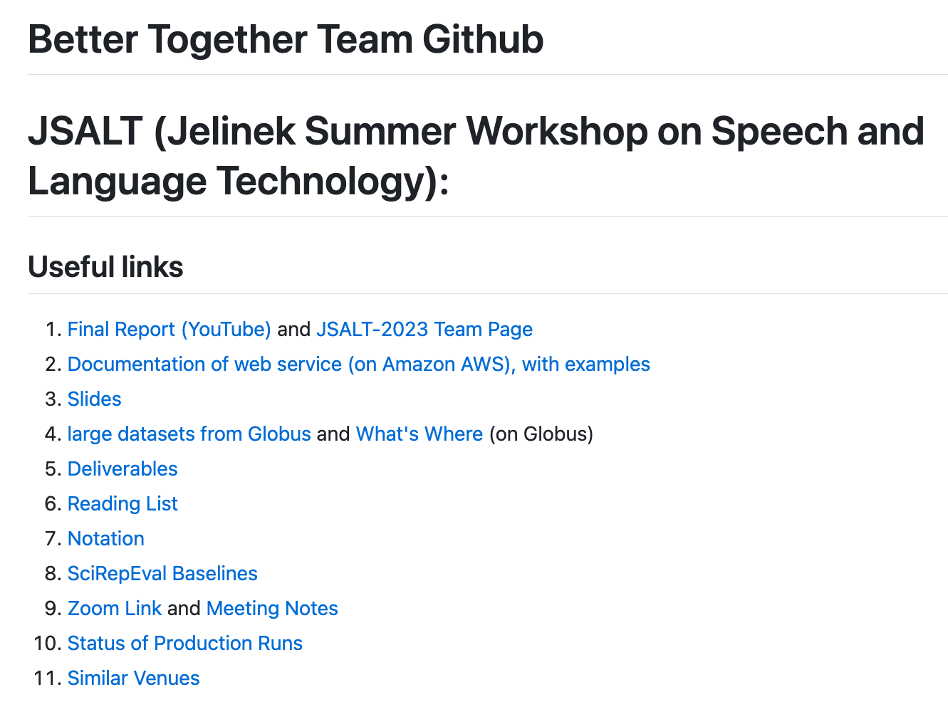
https://github.com/kwchurch/JSALT_Better_Together
YouTube
Web Page
including these slides

Slide 6
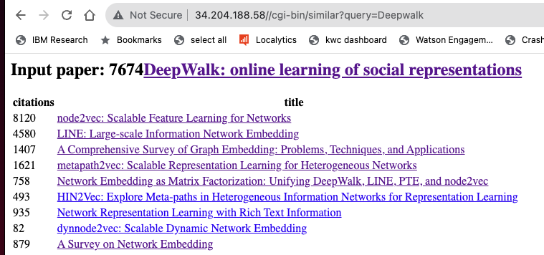
https://www.semanticscholar.org/product/api/gallery

Slide 7
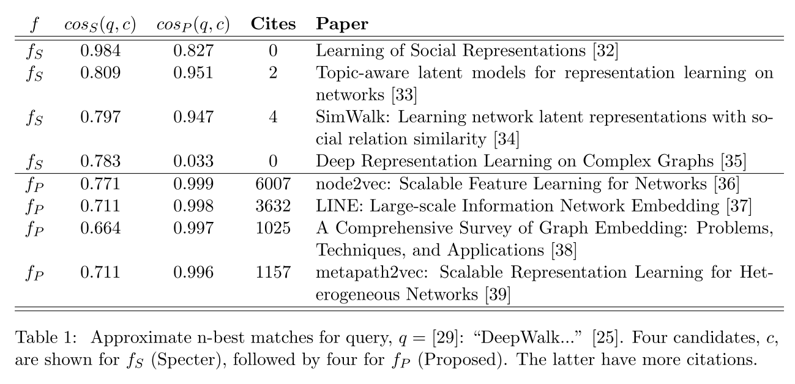
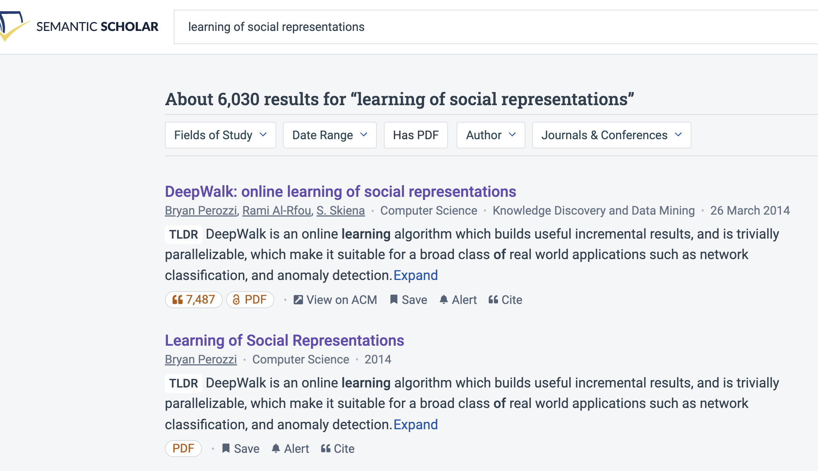
Query: ``DeepWalk: Online Learning of…’’

Slide 8
Recommendation: More than Word Overlap
Recommendations
What should I read?
What should I cite?
Many systems focus on ``relevance’’ (word overlap)
Better Together:
Text (word overlap) +
Context (citations)
Dups:
Not Good

Slide 9
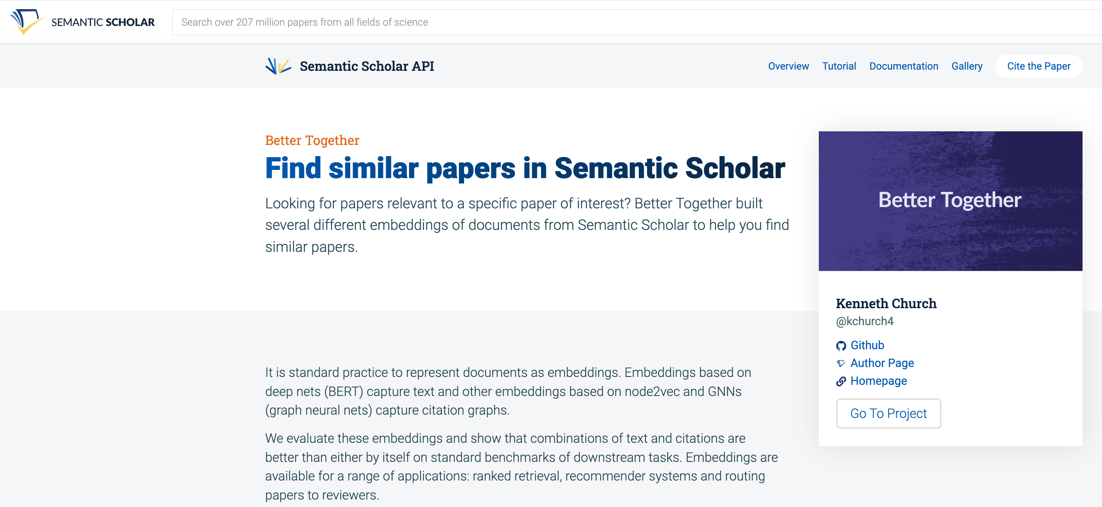
https://www.semanticscholar.org/product/api/gallery
click here

Slide 10

<return>

Slide 11
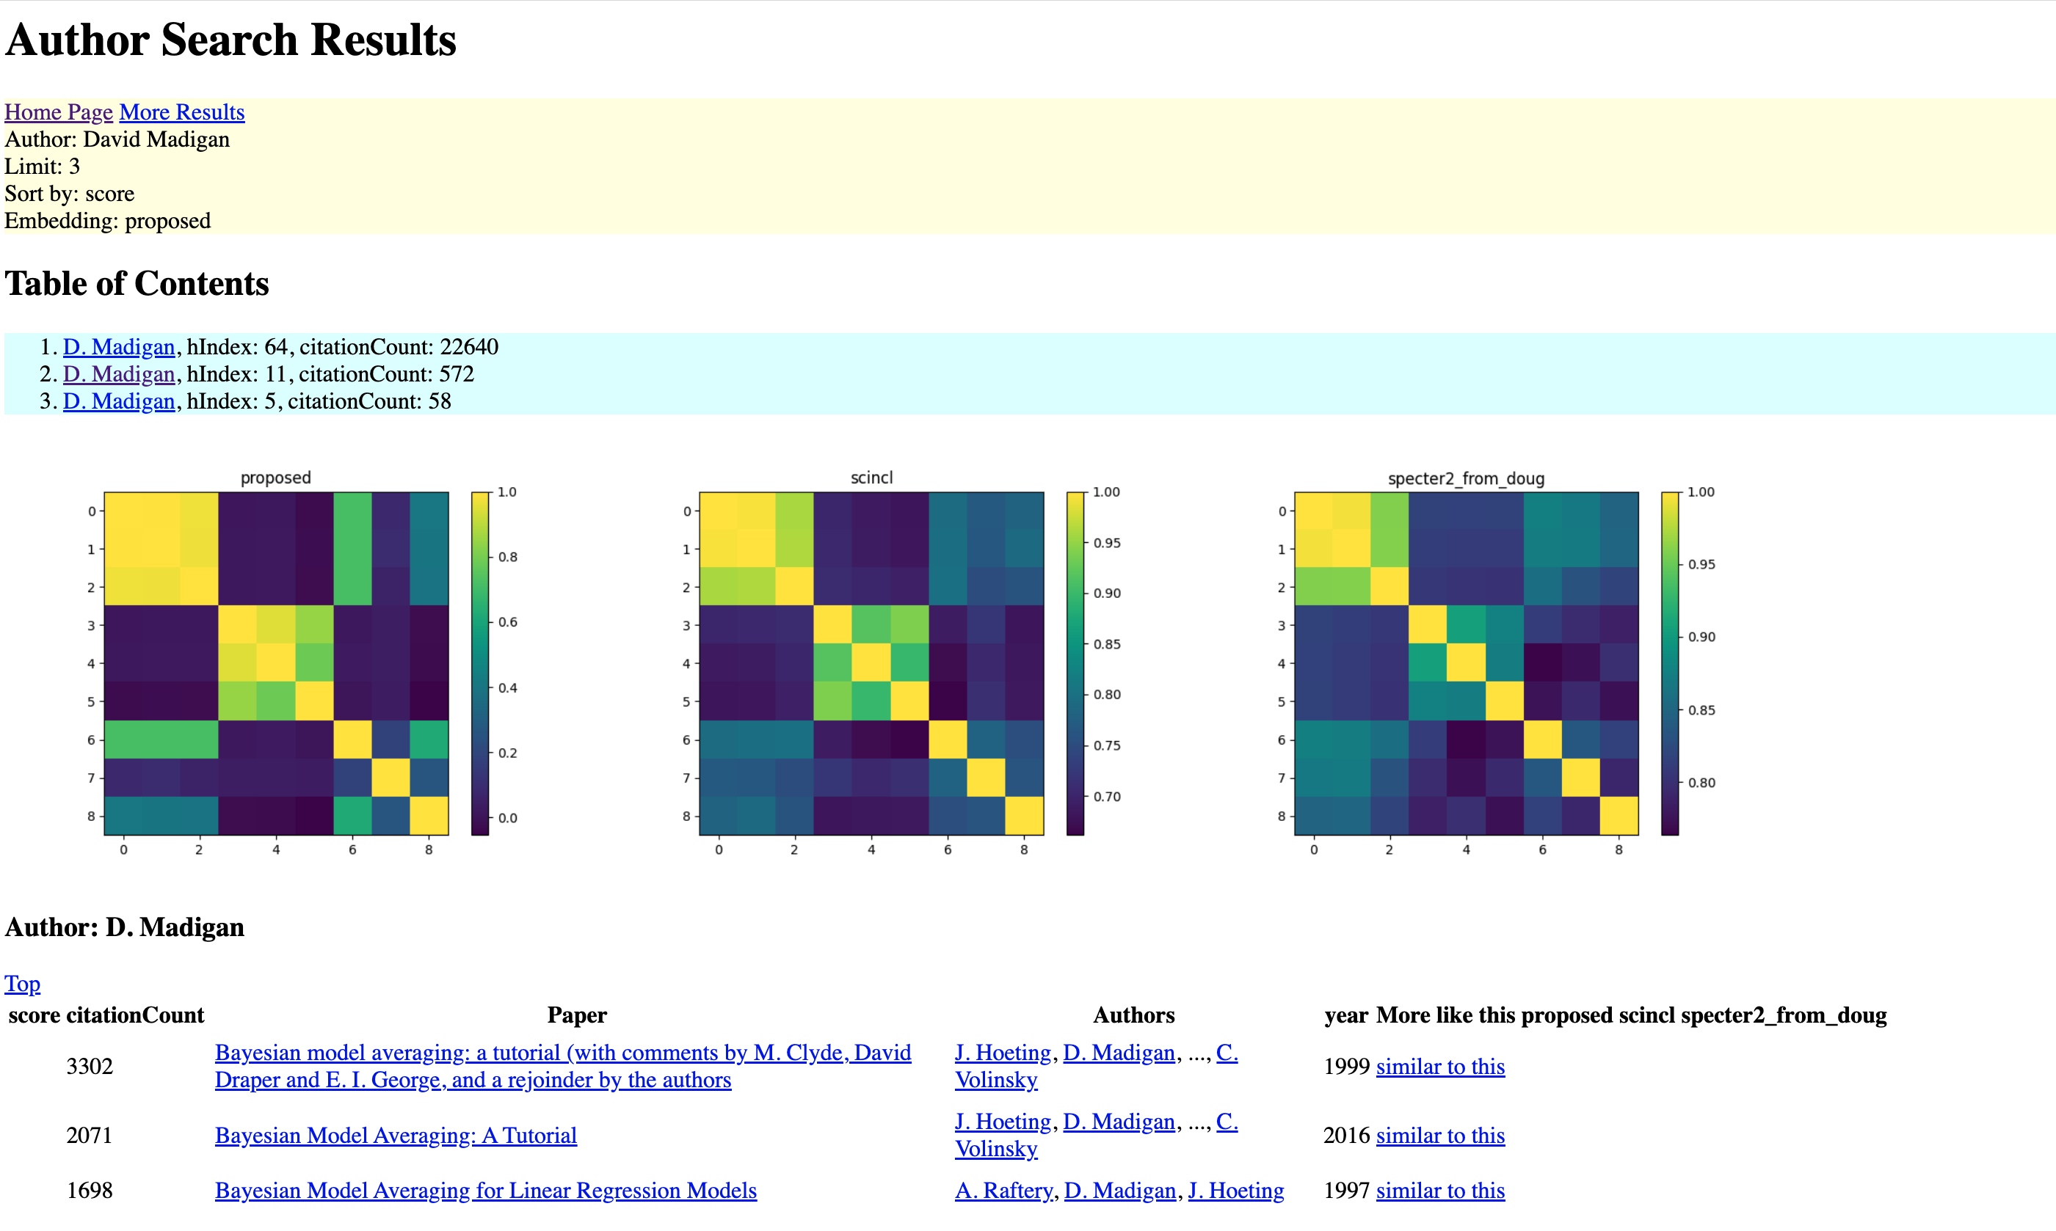
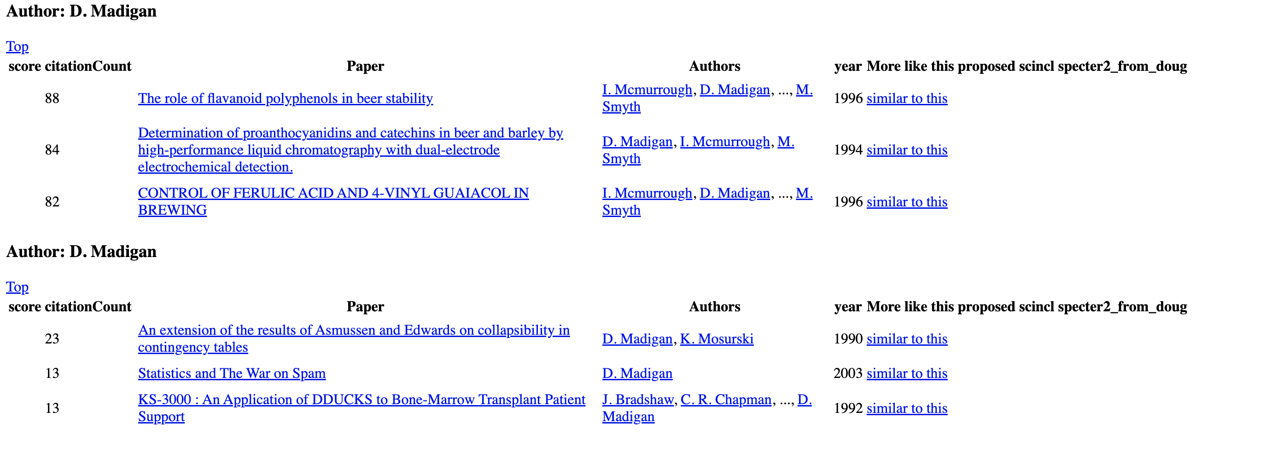
https://www.semanticscholar.org/api-gallery/better-together

Slide 12
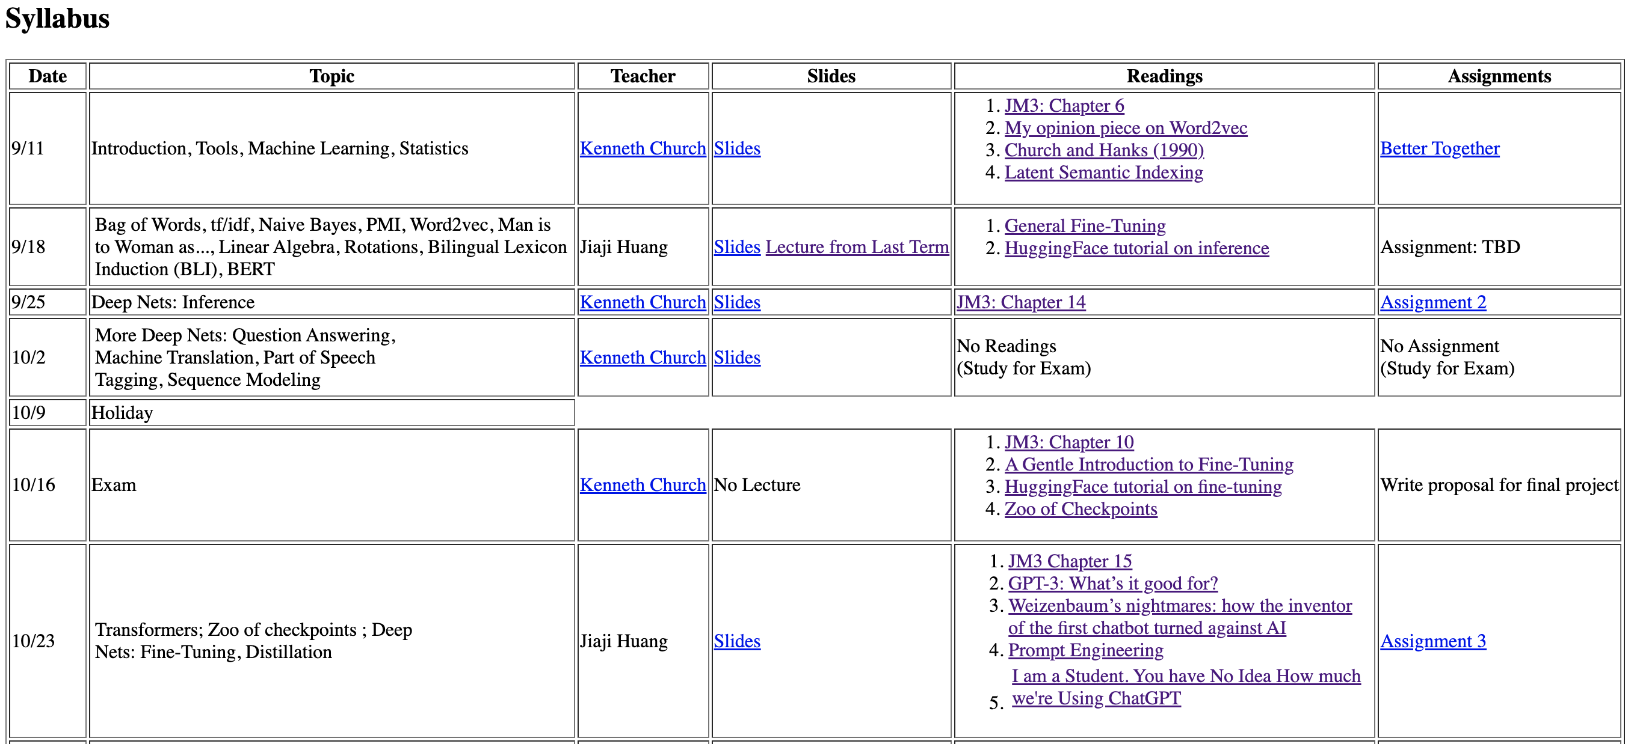
CS6120: Practical Natural Language Processing https://kwchurch.github.io/

Slide 13

Better Together: Text (Titles, Abstracts, Body); Context (Citations)
Specter, SciNCL
ProNE

Slide 14


Deliverables
GitHub:
massive (but needs editing)
slides, code, reading list
pointers to large files on Globus
Web Server
Recommendations
Input: queries (docs)
Output: recommendations (docs)
What Should I read? Cite?
Resources
Data behind web server:
citation graph
embeddings
indexes for approx. nearest neighbors
pairs of corpusIds with large cosines
all of the above for
Specter1, Specter2, SciNCL, ProNE
x100 bins for ProNE
Evaluations & Benchmarks
Intrinsic: Perplexity, Random Walks
Extrinsic: Local Citation Prediction

Slide 15
Opportunity: More Realistic Benchmarks
The Real World
Idealizations (Standard Benchmarks)
Large (Metcalfe’s Law)
Growing
Dirty
Missing Values
Bad/misleading Values
Small
Static
Clean

Slide 16
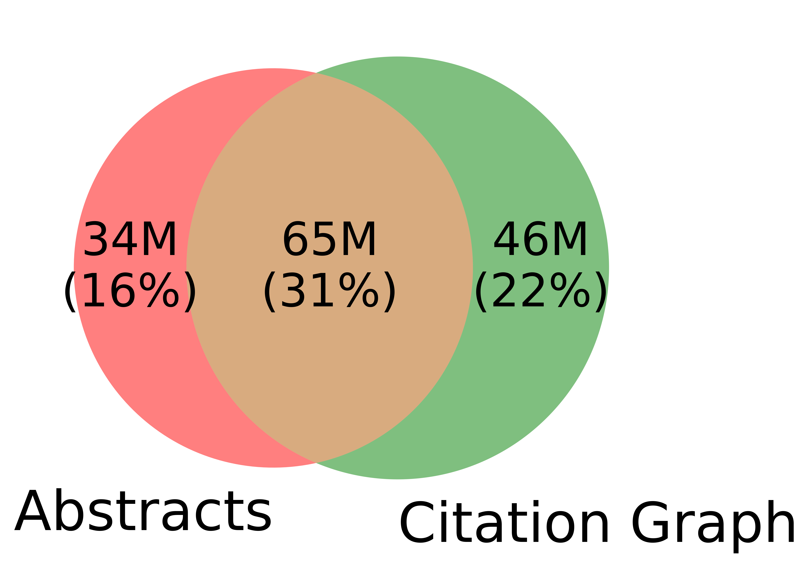
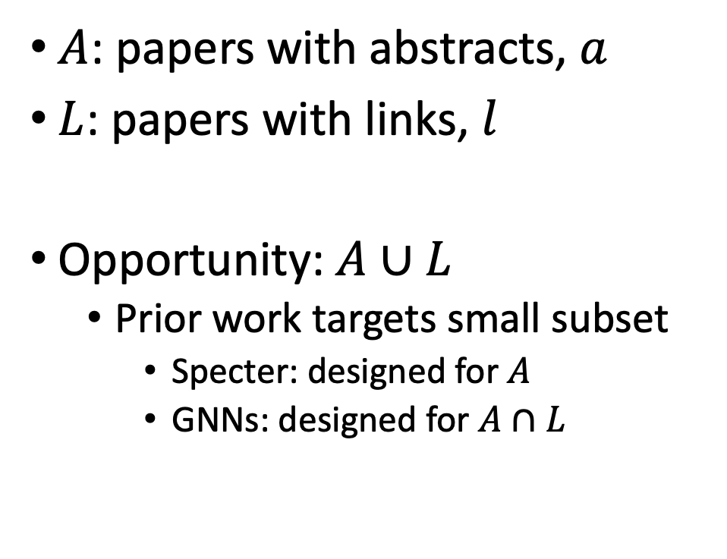
Realities (Dirty): Missing Values
$A$: papers with abstracts, $a$
$L$: papers with links, $l$
Opportunity:$A∪L$
Prior work targets small subset
Specter: designed for $A$
GNNs: designed for $A∩L$
Other
31%

Slide 17


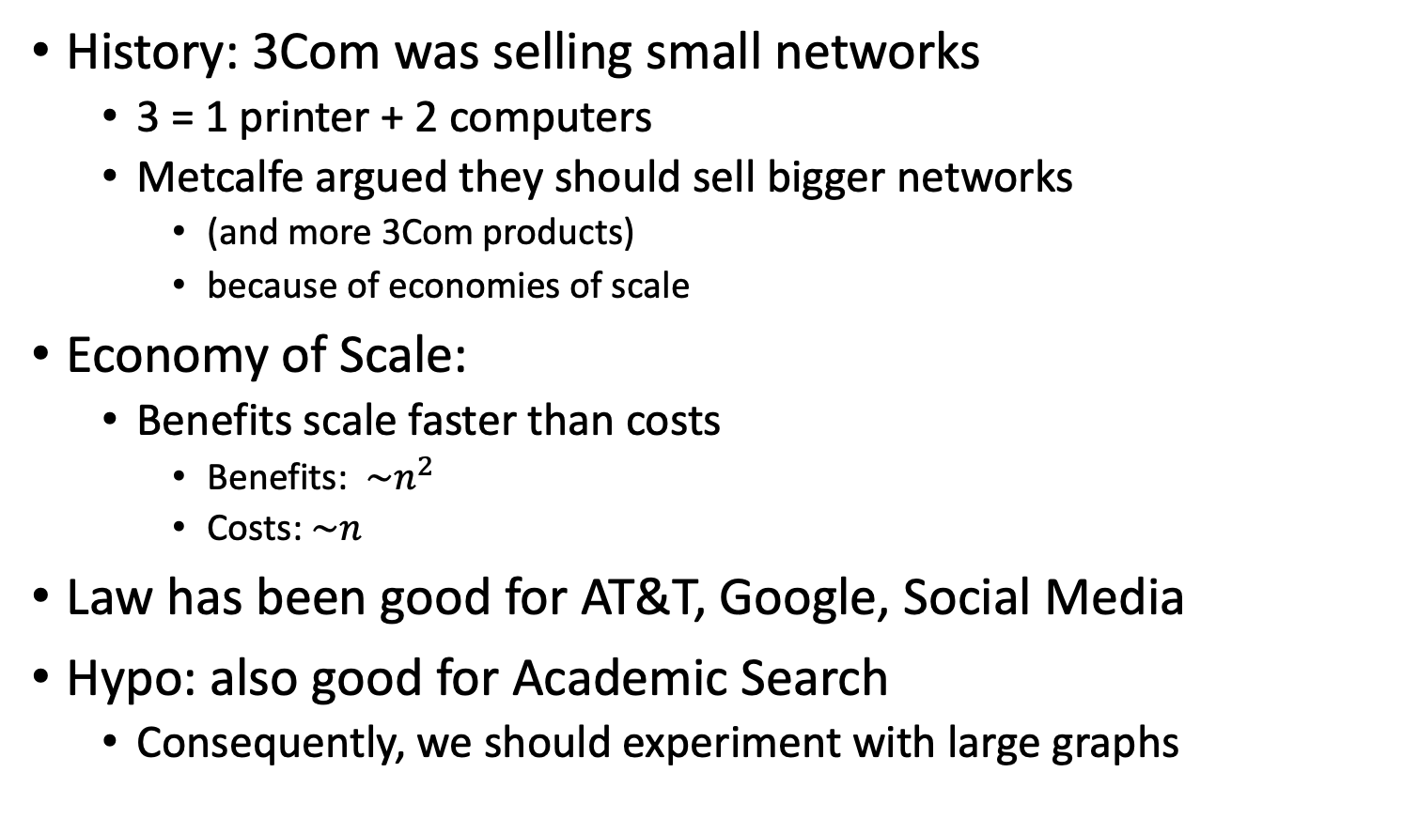
Metcalfe’s Law (Network Effects)
History: 3Com was selling small networks
3 = 1 printer + 2 computers
Metcalfe argued they should sell bigger networks
(and more 3Com products)
because of economies of scale
Economy of Scale:
Benefits scale faster than costs
Benefits: $\sim n^{2}$
Costs:$\sim n$
Law has been good for AT&T, Google, Social Media
Hypo: also good for Academic Search
Consequently, we should experiment with large graphs

Slide 18
Better-Together Conjectures
Multiple representations are helpful
for missing values (and bad values)
If abstracts are missing, use links
If links are missing, use abstracts
and for graphs of different sizes
When graphs are small:
Text >> Links
when graphs are large:
Links >> Text (Metcalfe’s Law)

Slide 19
Opportunities
Scale
Prediction
Many benchmarks return a single number (figure of merit)
How does performance scale
with the size of the problem?
Standard test/train splits
More relevant to interpolation
than extrapolation
Time is asymmetric
It is difficult to make predictions
especially about the future
-- Yogi Berra

Slide 20
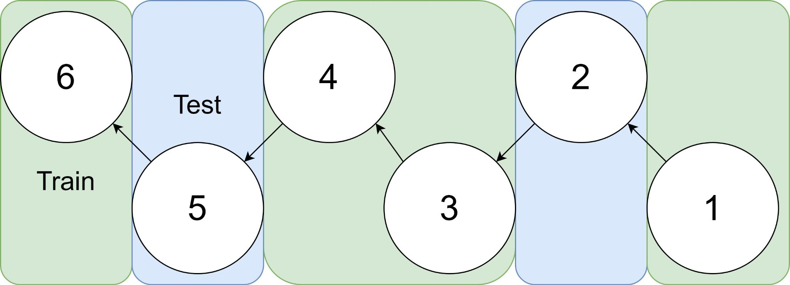
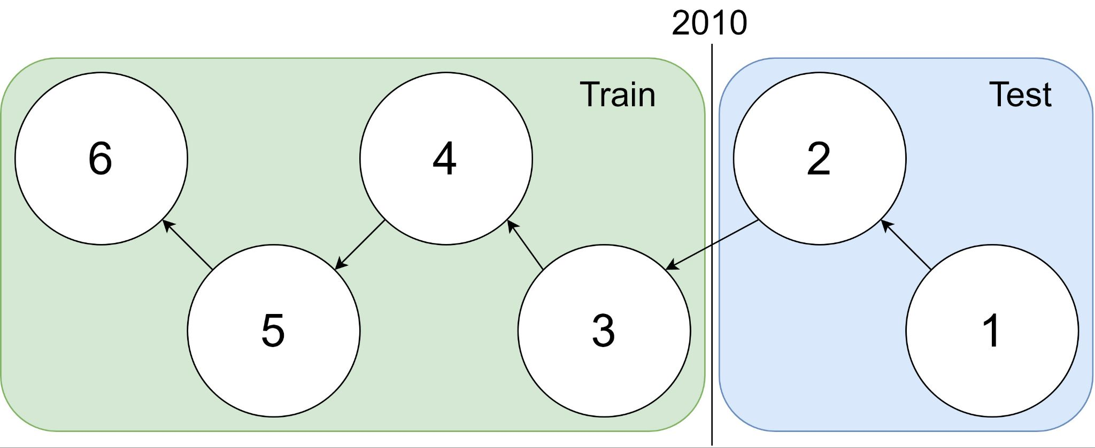
Example: 1 cites 2, 2 cites 3, … 5 cites 6
Traditional Train-Test Split (Non-Causal)
idx | Pub Year | Paper Title
1 | 2018 | [...] Photofragment imaging
2 | 2016 | Convenient probe of S(1D2)[...]
3 | 2005 | Megapixel ion imaging [...]
4 | 2003 | Direct current slice imaging [...]
5 | 1995 | profiles of Cl(2Pj) photofragments [...]
6 | 1988 | Adiabatic dissociation of [...]
Proposed Train-Test Splits (Causal)
Notes:
No asymmetry of time - how to reduce to a soundbite
Audience soundbites
‘Almost all studies in ml do test-train split’ that’s a bad idea when you have time

Slide 21
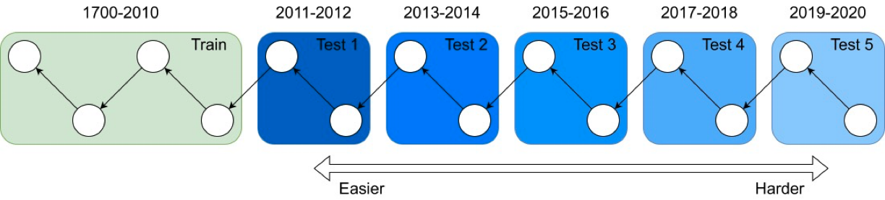
It's tough to make predictions, especially about the future ― Yogi Berra
Forecasting: short-term predictions are easier than long-term

Slide 22
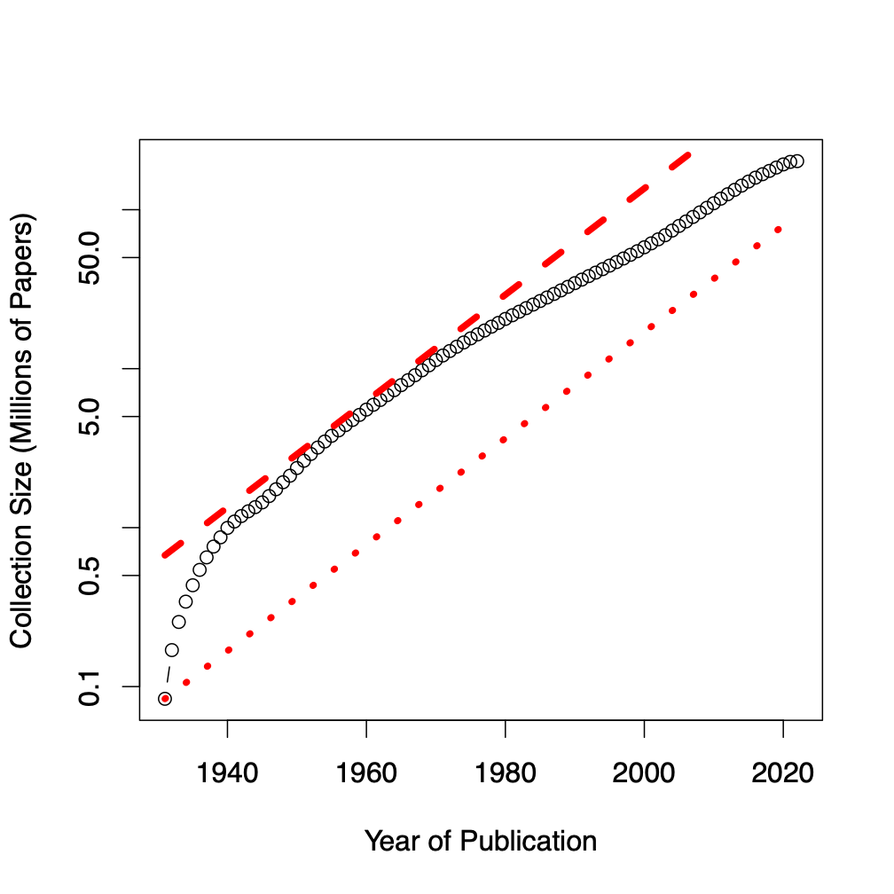
Assign 200M papers to 100 bins (by time)
Sort 200M papers by publication date
Output: Split papers into 100 bins, with 2M papers/bin
Because of exponential growth
(literature doubles every 9 years)
older bins span more time, and
newer bins span less time
Bin 99
………
Bin 0
Time
90% of literature published after I went to grad school
Notes:
mention equal # papers
consider replacing w/ diagram

Slide 23
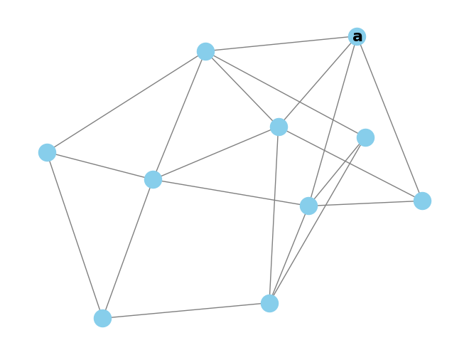
Intrinsic Evaluation - Random Walk Classification
Randomly pick start paper a

Slide 24
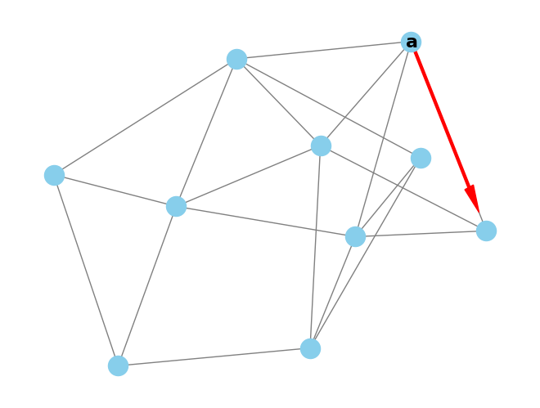
Intrinsic Evaluation - Random Walk Classification
Randomly pick start paper a
Jump to any referenced or citing paper

Slide 25
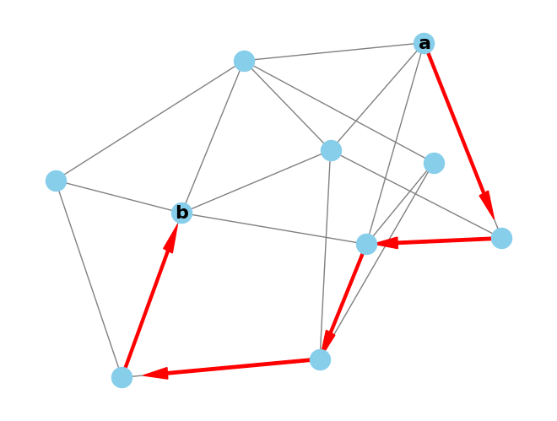
Intrinsic Evaluation - Random Walk Classification
Randomly pick start paper a
Jump to any referenced or citing paper
Repeat to reach final paper b

Slide 26
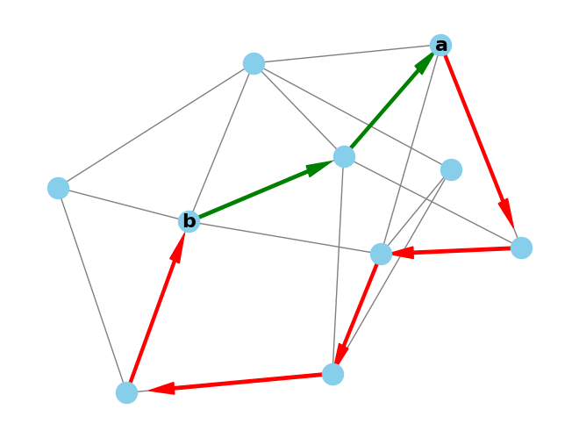
Intrinsic Evaluation - Random Walk Classification
Randomly pick start paper a
Jump to any referenced or citing paper
Repeat to reach final paper b
Verify the shortest path between a and b is in [1,4]
= 2-hop

Slide 27
Intrinsic Evaluation - Random Walk Classification
Randomly pick start paper a
Jump to any referenced or citing paper
Repeat to reach final paper b
Verify the shortest path between a and b is in [1,4]
It’s cheap to collect these of random walks, we have 3M
Hypothesis: representation models should have higher similarity for 1 hop than 2-4 hops.

Slide 28
Intrinsic Evaluation - Random Walk Forecasting
Can assign walks to bins for forecast evaluation
Walk bin = max(bin(a), bin(b))
Given the ProNE trained models, how well can they:
Remember from train (bin<=train split)
Predict the future (bin>train split)
Does this get harder as bin >> train split?

Slide 29
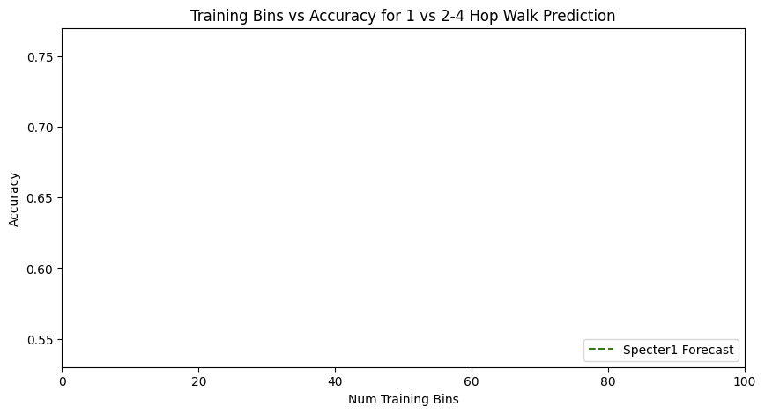
Forecasting with Text

Slide 30
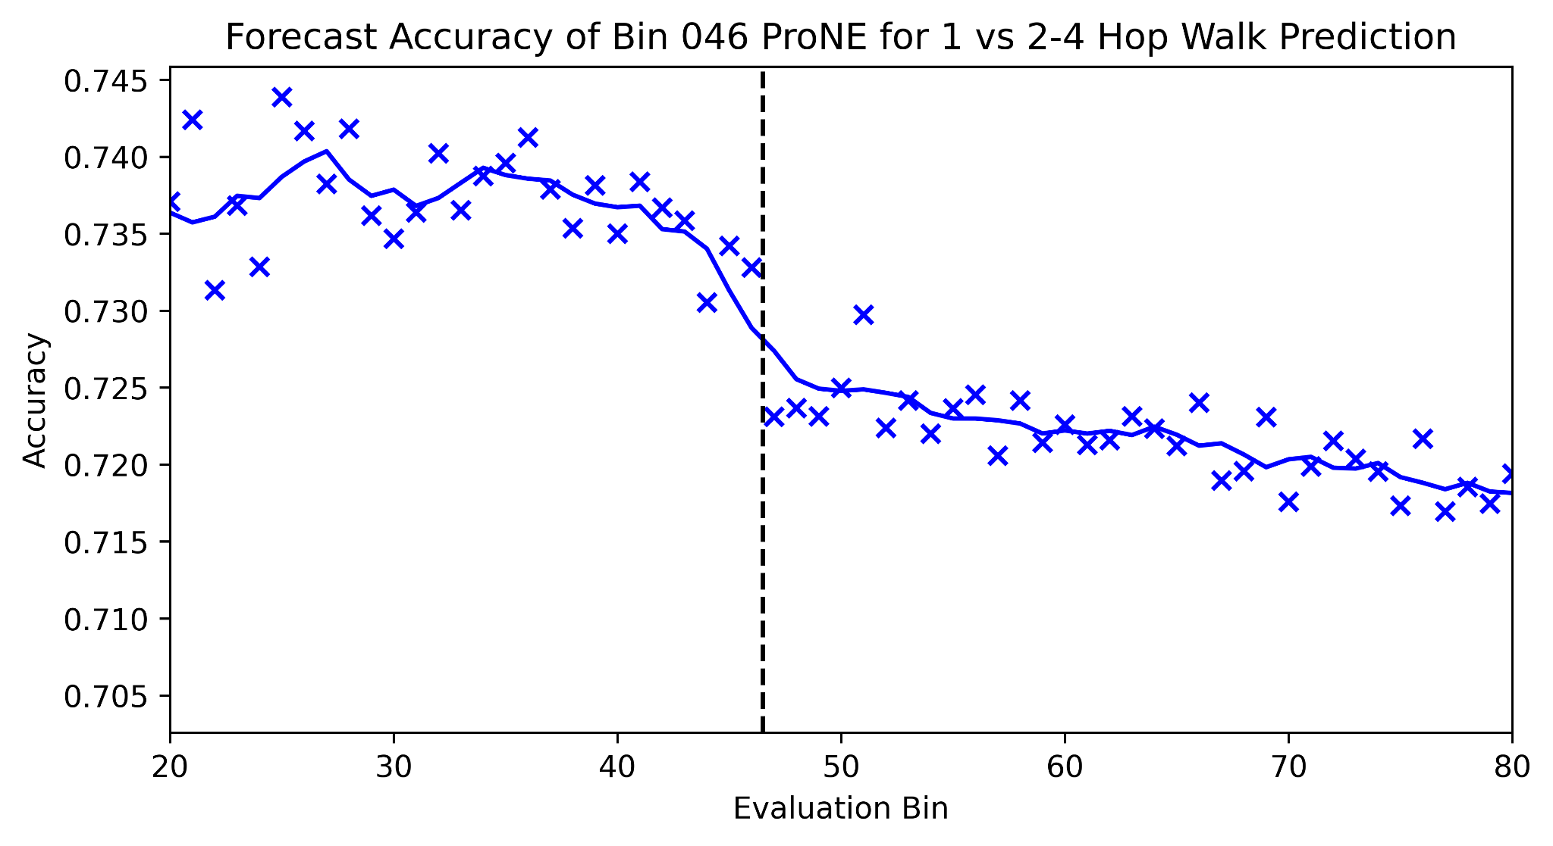
Forecasting from Bin 46

Slide 31
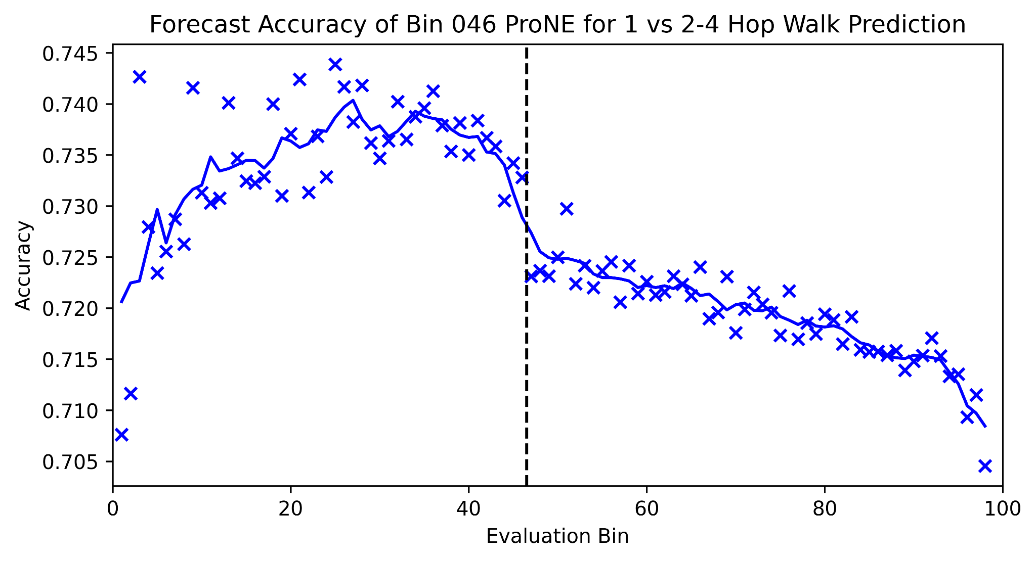
Forecasting from Bin 46 - Full Picture

Slide 32
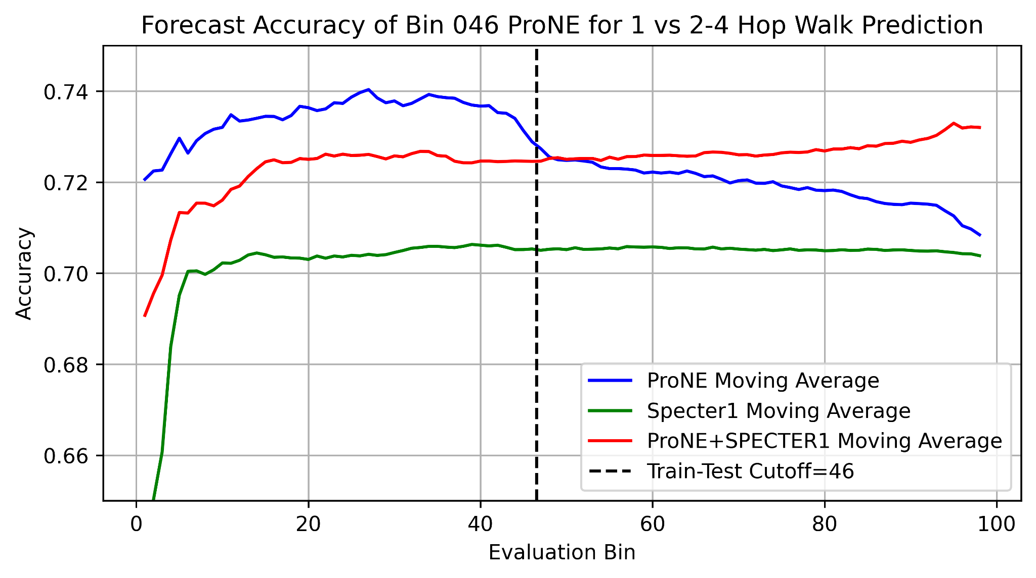
Better Together Observations
ProNE (Context) >> Specter (Text)
Ensembles are better
than either by itself
Text is most helpful
when links are not working well
i.e., long-term forecasting

Slide 33
Conclusion: Deliverables https://kwchurch.github.io/
GitHub:
massive (but needs editing)
slides, code, reading list
pointers to large files on Globus
Web Server
Recommendations
Input: queries (docs)
Output: recommendations (docs)
What Should I read? Cite?
Resources
Data behind web server:
citation graph
embeddings
indexes for approx. nearest neighbors
pairs of corpusIds with large cosines
all of the above for
Specter1, Specter2, SciNCL, ProNE
x100 bins for ProNE
Evaluations & Benchmarks
Intrinsic: Perplexity, Random Walks
Extrinsic: Local Citation Prediction

